Slide 1


Slide 1
Analyzing Spotify songs’ popularity and audio features
Cindy Khuu
IST 652 Scripting for Data Analysis
6/4/19
Notes:
https://www.stickpng.com/img/icons-logos-emojis/tech-companies/spotify-green-logo

Slide 2
Main Data
Data: Spotify Audio Features (April 2019) from Kaggle
Type: Structured Data
Description: Includes 130,663 tracks combination of songs, podcasts, and live music recordings with 13 audio features & popularity
Columns:
Artist name
Track name
Track ID – Spotify ID
Popularity – Based on number of plays
Danceability – how suitable for dancing combo of beat, tempo, & rhythm
Loudness – amplitude or sounds strength in decibel
Energy – perceived intensity and activity usually fast, loud, and noisy
Duration (milliseconds) – duration of track
Instrumentalness – confidence there are no vocals
Key – key track is in using ex: C or C#
Liveness- Presence of audience in recording
Mode- Major or minor scale
Speechiness- Presence of spoken words
Tempo-speed or pace using beats per minute relative to average
Time Signature- number of beats per measure
Valence- measure musical positiveness
Acousticness – confidence track is acoustic
Note: Refer to data dictionary for more details
Source: https://www.kaggle.com/tomigelo/spotify-audio-features
2
Notes:
https://www.kaggle.com/
https://www.stickpng.com/img/icons-logos-emojis/tech-companies/spotify-green-logo

Slide 3
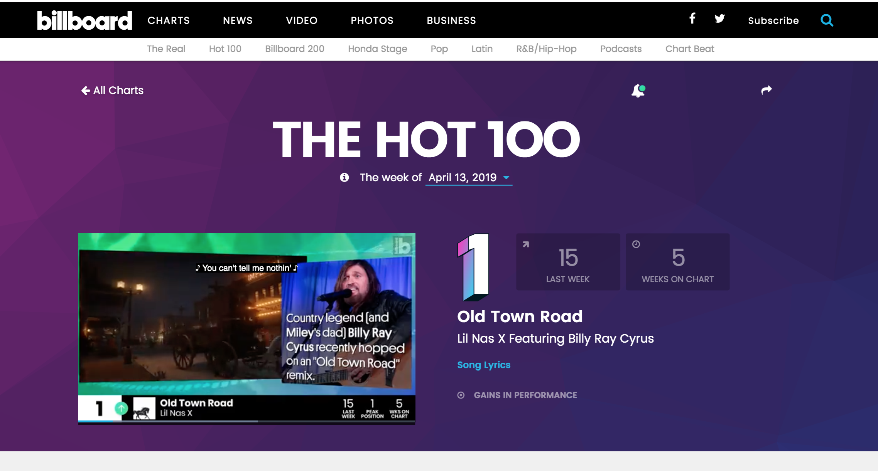
Supporting Data
Data: Billboard Hot 100 (4/13/19)
Type: HTML Semi-Structured Data
Description: top 100 high-ranking songs based on interactions with the song from track downloads, radio plays, and online streams
Columns:
Artist name
Track name
Rank
Source: https://www.billboard.com/charts/hot-100/2019-04-13
3
Notes:
https://en.wikipedia.org/wiki/File:Billboard_Hot_100_logo.jpg

Slide 4
Goals/Methods of Analysis
Understand summary statistics and distribution of all Spotify tracks by audio feature and popularity
Validate popularity of Spotify tracks with external source Billboard Music Charts using match rate
Define and compare relationships amongst audio features and popularity using correlations
Compare audio features averages by bucketed popularity types to discover trends amongst the types
Find best classification model to predict popularity type using audio features
4

Slide 5
Overall Program Description
Part 1) Spotify Dataset
Data: Import Spotify dataset into pandas dataframe
Data Processing: Renaming column fields, replacing missing values with the mean, and conforming string data type fields for artist_name and track_name using lowercase string function
Create Outputs: summary statistics output, histogram charts, and correlation matrix heatmap
Create Popularity Types: popular, average, and less_popular based on the popularity score by adding a new column to Spotify dataframe and then summarizes all the audio features using describe() function
Part 2) Webscraping & Using Supporting Data
Data: Retrieve from the html link to get the Billboard Hot 100 Music Chart, getting the artist name, track name, and rank on the charts into three separate lists, which is then combined into a single pandas dataframe
Data Processing: conform artist name and track name to those in the Spotify dataset, using lower case string function and manually replacing values.
Create Output: create new dataframe for top 100 popular Spotify tracks and merge with Billboard dataframe, keeping all records of the top 100 popular Spotify songs
Part 3) Modeling
Execute 5 different classification algorithms using the Y variable as the popularity attribute type and the X variables as the audio features and prints out the accuracy for each model
4

Slide 6
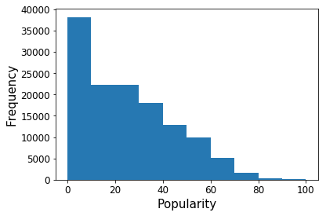
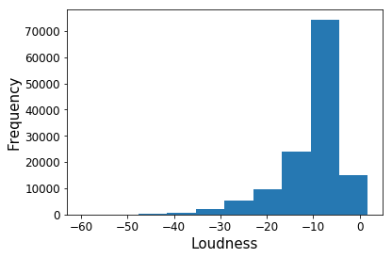
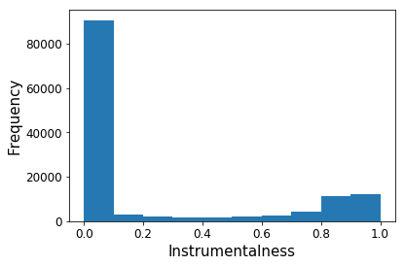
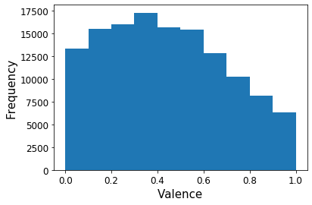
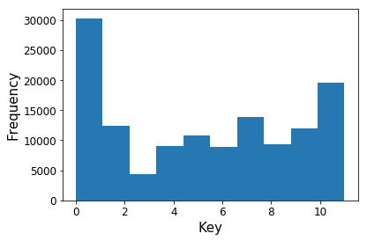
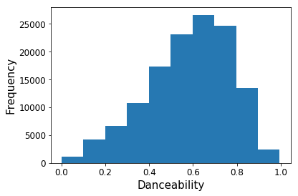
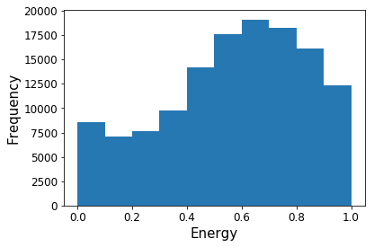
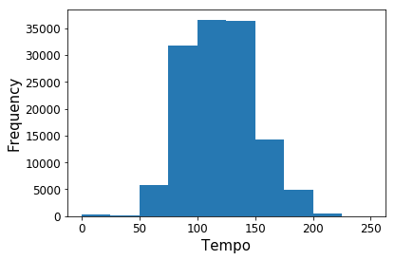
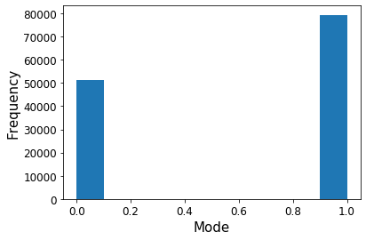
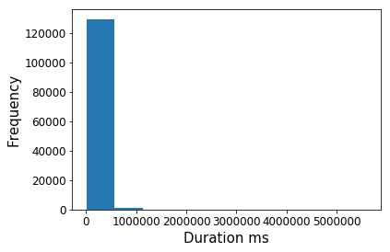
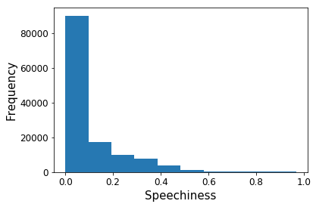
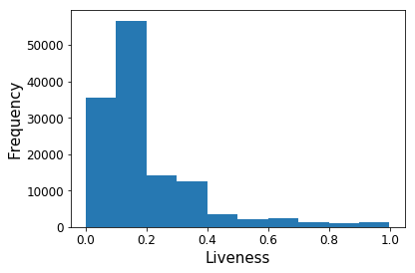
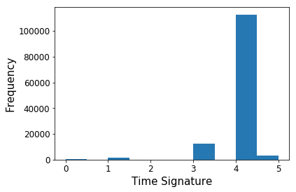
Slide 2
What’s the distribution and summary statistics of Spotify popularity and audio features?
Mean = -10
Mean = 0.22
Mean = 0.44
Mean = 5
Mean = 24
Mean = 0.58
Mean = 0.57
Mean = 119
Mean = 0.61
Mean = 212633
Mean = 0.34
Mean = 0.11
Mean = 0.20
Mean = 4
Program: Used pandas describe() function for summary statistics and matplot for histogram
Observations: Popularity is skewed to the right with less number of tracks with high scores. Less variation in Mode, Time Signature, and Duration since there are limited values. Tracks in the dataset are mostly recorded music and not live recording, audio books, podcasts, or speeches
5

Slide 7


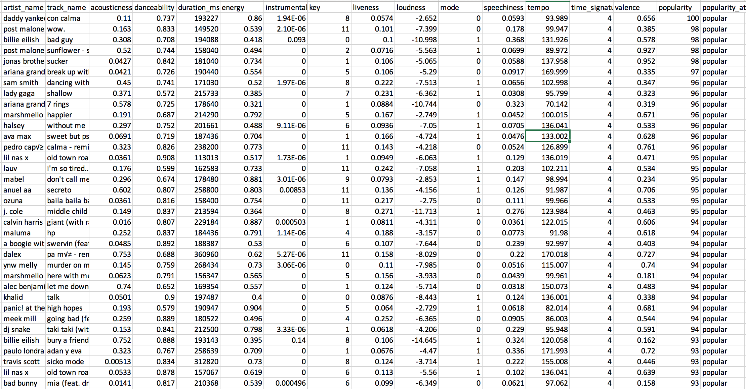
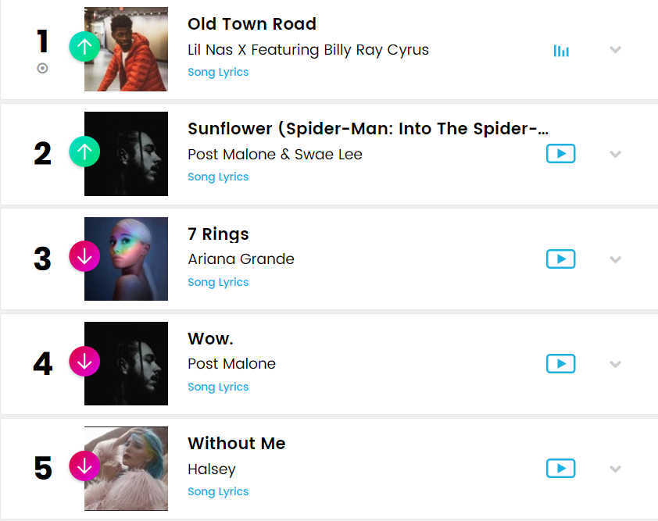
Slide 8
How valid is the Spotify popularity score when compared to Billboard’s Hot Music Charts?
Match Rate
51%
Good considered there’s over 130K songs in entire Spotify dataset
Program: Used Beautifulsoup to web scrape Billboard and pandas merge () function on both datasets based on artist name and track name
7
Notes:
https://www.kisspng.com/png-logo-hornblower-cruises-events-brand-font-billboar-5916581/preview.html

Slide 8
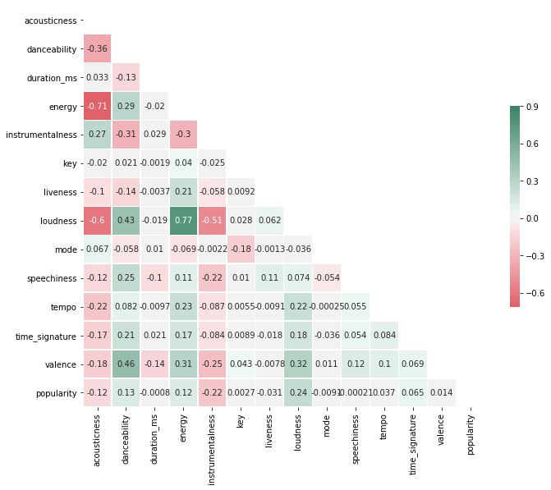
Slide 3
How do correlations compare amongst popularity and audio features?
POPULARITY
+24%
-22%
LOUDNESS
INSTRUMENTAL
+77% Energy
+43% Danceability
-60% Acousticness
-51% Instrumental
+27% Acousticness
-31% Danceability
-30% Energy
-51% Loudness
+13%
-12%
DANCEABILITY
ACOUSTICNESS
+46% Valence
+43% Loudness
+29% Energy
-36% Acousticness
-31% Instrumental
+27 Instrumental
-36% Danceability
-60% Loudness
-71% Energy
Program: Used matplotlib.pyplot as plt, seaborn, and numpy to create correlation heat map
Observations: For popularity, weak positive relationships with Loudness and Danceability and weak negative relationships with Instrumentalness and Acousticness, but for these mentioned audio features, there are strong relations amongst each other with similar type of +/- relationship related to popularity. Overall, most likely not able to use regression model to predict popularity score
6

Slide 9
Slide 3
What are observed patterns when comparing audio features for each popularity type?
Mean of Audio Features by Popularity Type
Popularity Types Based on Popularity Score to preserve intended value of score from a 1 to 100 scale:
Popular >= 50, Average <50 and >=25, Less Popular <25
Distribution of Data in the Popularity Types:
Popular 13.1%, Average =31.5%, Less Popular = 55.4%
Some audio features exhibit a more distinct pattern with Less Popular type having the lowest value and Popular type having the highest value or vice versa such as:
Danceability, Valence, Loudness, and Key
Other audio features exhibit irregular pattern
Program: Used user-defined function to create popularity types based on popularity score (Popular >= 50, Average <50 and >= 25, Less Popular<25) and pandas describe() function for summary statistics
Observations: Comparing audio features for each popularity type, there are some audio features that show some pattern where the Less Popular type has lowest value for that feature, Average type has the middle value, and the Popular type has the highest value or vice versa in that order
8

Slide 10
Slide 5
Which classification method has highest prediction accuracy for popularity type?
Y = Popularity Type (Popular, Average, Below Average)
X Variables = Audio features
Data Split = 80% Training / 20% Testing
K-Nearest
Neighbors
Neural
Network
Muli Logistic
Regression
Support Vector
Machine
Random
Forest
54.82%
55.42%
55.69%
55.99%
56.73%
Program: Used sklearn package with train_test_split, LogisticRegression, RandomForestClassifier, MLPClassifier, SVM, and MLPClassifier
Observations: Out of the five types of classification method used on the same dataset, Random Forest had the highest prediction accuracy rate of 56.73%, which is only 0.97% better than when just guessing Less Popular for a track.
9

Slide 11
Slide 1
Conclusion
Spotify popularity distribution is skewed with more tracks with lower scores, making popular tracks very rare
Audio features do have strong relationships amongst each other but not with popularity score
Potential patterns identified when viewing audio features bucketed into different popularity types
Using classification methods to predict a tracks popularity based on audio features, Random Forest had best prediction accuracy rate 56.37%, but it was only 1.33% better than guessing Less Popular
Overall, music is composed in various complex ways and various audio features that it doesn’t fully translate to more plays, which drives the logic for Spotify’s popularity score
Opportunity to try to add other predictors such as genre of the track or popularity score of an artist of the track
10
Notes:
https://www.stickpng.com/img/icons-logos-emojis/tech-companies/spotify-green-logo

Slide 12
Slide 1
Questions?
11
Notes:
https://www.stickpng.com/img/icons-logos-emojis/tech-companies/spotify-green-logo

Slide 13
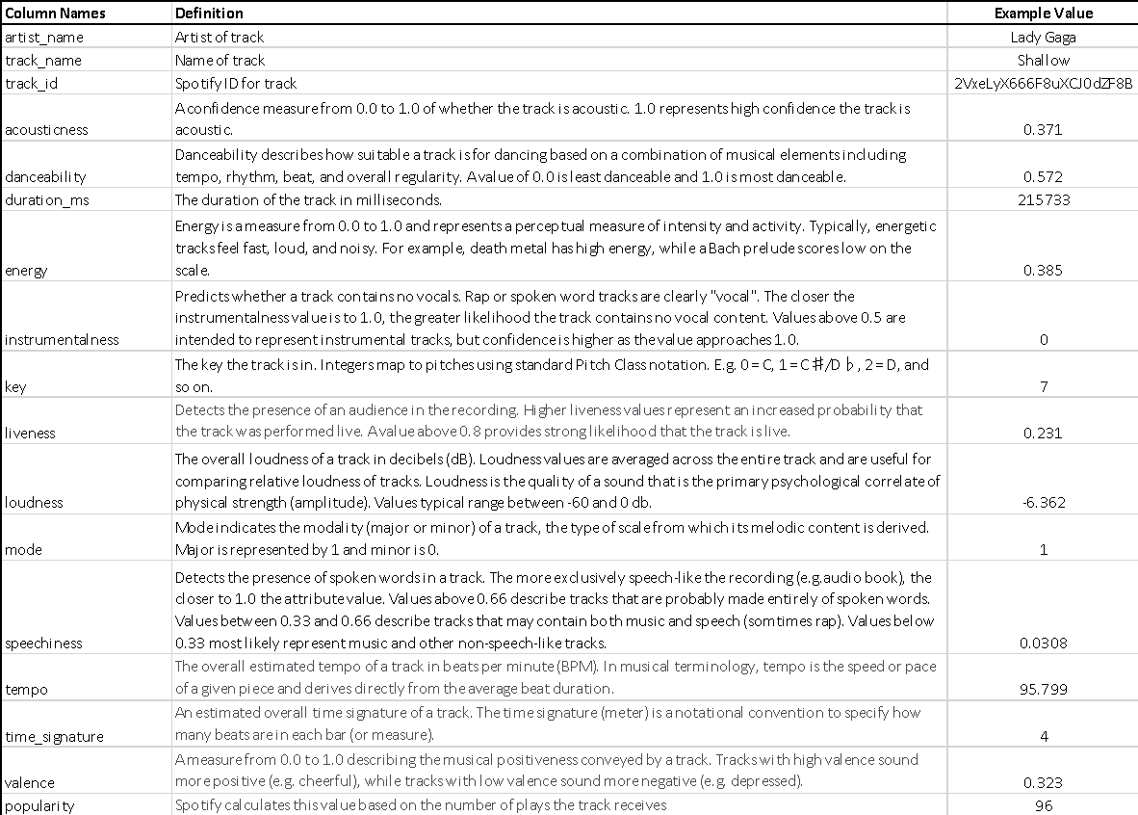
Spotify Data Dictionary
12

Slide 14
Sources
https://www.kaggle.com/tomigelo/spotify-audio-features
https://www.billboard.com/charts/hot-100/2019-04-13
https://www.kisspng.com/png-logo-hornblower-cruises-events-brand-font-billboar-5916581/preview.html
https://www.stickpng.com/img/icons-logos-emojis/tech-companies/spotify-green-logo
https://stackabuse.com/classification-in-python-with-scikit-learn-and-pandas/
http://seaborn.pydata.org/examples/many_pairwise_correlations.html
https://www.kaggle.com/
https://en.wikipedia.org/wiki/File:Billboard_Hot_100_logo.jpg
13

